Slide 1
Landslide Detection with Multi-Spectral Satellite Imagery and Image Segmentation
PROJECT BY –
RITIK NEHRA
Under the guidance of -
Dr. Dhanalakshmi R

Slide 2
Introduction
Landslides are a significant natural hazard, especially in mountainous and hilly terrains, leading to loss of life, infrastructure damage, and environmental destruction. Traditional methods of landslide detection, such as field surveys and visual inspections, are time-consuming and often impractical for large or remote areas. With the advancement of satellite technology, remote sensing techniques have emerged as a powerful tool for landslide detection. Multi-spectral satellite imagery, including features such as NDVI (Normalized Difference Vegetation Index), DEM (Digital Elevation Model), Slope, and RGB images, provides valuable insights into the conditions of terrain that are prone to landslides, making it ideal for developing automated systems for landslide detection.

Slide 3
Introduction
In recent years, deep learning-based image segmentation models, particularly UNet and FCN (Fully Convolutional Networks), have shown considerable promise in geospatial applications, including landslide detection. These models are capable of performing pixel-wise classification, allowing them to precisely identify areas affected by landslides. This study explores the use of UNet and FCN architectures for landslide detection, evaluating their effectiveness on multi-spectral satellite imagery. By comparing the segmentation performance of these models, we aim to identify the most suitable approach for landslide detection, ultimately contributing to disaster mitigation efforts and early warning systems in landslide-prone regions.

Slide 4
Literature Survey:
Early approaches to landslide prediction involved traditional machine learning techniques like logistic regression, decision trees, and support vector machines (SVM). Bui et al. (2016) [1] used SVM to classify landslide-prone areas, integrating spatial and environmental variables such as slope, land cover, and rainfall. Although SVM showed promise, its ability to handle high-dimensional, unstructured data (e.g., images) was limited.
CNNs have revolutionized the field of image recognition, making them suitable for landslide prediction based on remote sensing and satellite images. Meena et al. (2019) [2] utilized CNN to classify landslide occurrences using satellite imagery and topographic features, demonstrating a marked improvement over traditional methods. CNN's ability to learn spatial hierarchies from images allowed for more accurate classification, yet one limitation noted was the difficulty in detecting small-scale landslides.

Slide 5
Literature Survey:
U-Net, originally proposed by Ronneberger et al. (2015) [4], is a popular architecture for biomedical image segmentation and has since been applied to landslide detection. The U-Net model, with its contracting and expansive paths, is well-suited for identifying the exact locations of landslides in an image.
Wang et al. (2021) [5] applied U-Net to detect landslide regions in satellite images. Their study demonstrated that U-Net could effectively segment landslide-affected areas and produce pixel-level accuracy, outperforming conventional methods. The primary advantage of U-Net over CNN is its ability to predict landslide boundaries and the precise regions affected, which is essential for practical disaster management applications.
Deep learning techniques, particularly CNN and U-Net architectures, have shown great promise in improving landslide prediction accuracy. CNN models excel in classification tasks, while U-Net offers powerful segmentation capabilities that can detect landslide-affected regions at the pixel level. Hybrid models combining the strengths of both CNN and U-Net have demonstrated superior performance in complex terrains. However, challenges such as data availability and real-time prediction remain. Future work should focus on developing more robust models, incorporating diverse data types, and exploring transfer learning techniques to further enhance landslide prediction systems.

Slide 6
Problem statement :
Landslides present a significant threat to human life and infrastructure, especially in areas with steep slopes and heavy rainfall. Traditional methods of detecting landslides, such as manual inspections, are often slow and limited in coverage. With the rise of satellite imagery and remote sensing data, there is an opportunity to automate landslide detection using image segmentation techniques. However, accurately detecting landslides from multi-spectral data remains challenging due to the complexity of the terrain and the need to capture key features such as vegetation, slope, and elevation. This research aims to explore and compare the performance of UNet and FCN deep learning models for landslide detection, leveraging multi-spectral satellite imagery to improve detection accuracy and provide a more efficient, scalable solution for real-time landslide monitoring.

Slide 7
OBJECTIVE :
Investigate the use of key landslide-related features such as NDVI, DEM, Slope, and RGB images for enhancing landslide detection accuracy.
Compare the performance of two deep learning models, UNet and FCN, in terms of precision, recall, and F1 score for pixel-wise landslide segmentation.
Evaluate the effectiveness of each model in identifying and delineating landslides from multi-spectral satellite images, with a focus on improving detection in challenging terrains.
Provide insights into the potential for real-time landslide monitoring and disaster mitigation through automated detection systems using remote sensing data.

Slide 8
Proposed System Introduction
The proposed system leverages multi-spectral satellite imagery to detect landslides using advanced image segmentation techniques. By integrating various landslide-correlated features such as NDVI, DEM, Slope, and RGB images, the system aims to enhance the accuracy of landslide detection, providing early warnings to mitigate the risk of disasters. The core of the system is based on deep learning models—UNet and FCN—which are trained to segment landslide-prone areas from satellite images, enabling real-time monitoring and response.

Slide 9
The proposed system is designed with multiple integrated modules, each handling specific aspects of the landslide prediction process. The system begins with input data, including satellite imagery, digital elevation models, and multispectral data, which provide crucial geospatial information. This data then moves through a preprocessing stage to ensure quality and consistency, where it undergoes rescaling, filtering, and normalization. The processed data is subsequently input into two deep learning models: the CNN model, which performs classification to identify landslide-prone areas, and the U-Net model, which offers pixel-level segmentation to map out exact landslide boundaries. Finally, the outputs from these models are combined, resulting in a comprehensive map that highlights high-risk landslide zones. This map serves as a practical tool for disaster management by visualizing potential landslide areas in an easily interpretable format.

Slide 10
List of Modules
Data Collection: Acquisition of multi-spectral satellite imagery (RGB, NDVI, DEM, Slope).
Preprocessing: Image normalization and transformation to enhance input data for model training.
Model Training: Training of UNet and FCN models for pixel-wise segmentation.
Prediction & Evaluation: Segmenting and predicting landslide-prone areas, followed by model evaluation using performance metrics.
Post-processing & Visualization: Generating and visualizing the output with predicted landslide regions on the satellite images.

Slide 11
Explanation of Modules
Data Collection:
The satellite images used in this research consist of multiple spectral bands like RGB, NDVI (Normalized Difference Vegetation Index), DEM (Digital Elevation Model), and Slope data. These features help in identifying regions prone to landslides.NDVI provides vegetation health, DEM gives topographical information, and Slope gives terrain steepness, all critical for landslide prediction.
Preprocessing:
Normalization: To scale pixel values to a consistent range (e.g., 0 to 1) for better model performance.
Resizing: Adjusting the size of images to ensure they fit the input requirements of the segmentation models.
Data Augmentation: Applying transformations (rotation, flipping) to increase the variety and robustness of training data.

Slide 12
Explanation of Modules
Prediction & Evaluation:
Prediction: Once trained, both models (UNet and FCN) are applied to new satellite images to detect landslides. The output consists of segmented masks showing landslide regions.
Evaluation: Performance is measured using metrics like Precision, Recall, and F1 Score, comparing predicted results with ground truth data.
Post-processing & Visualization:
Visualization: The segmented images are overlaid with the ground truth and predictions, providing a visual representation of detected landslides.
Post-processing: Enhances the segmentation output by applying morphological operations to refine the boundaries of detected landslides.

Slide 13
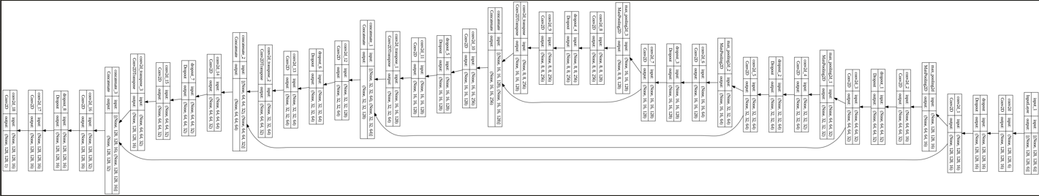
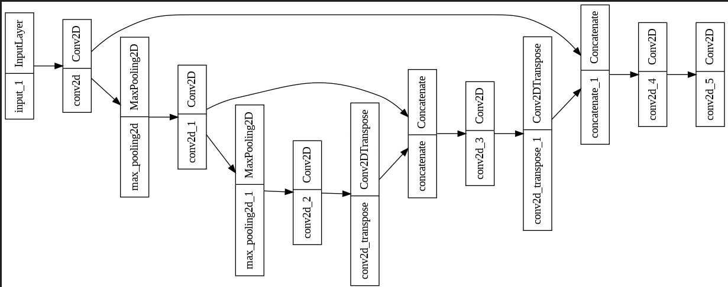
Models Architecture
UNET
FCN

Slide 14
Results Overview
We present the results of the land-slide detection task using the UNet and FCN models trained on multi-spectral satellite imagery, including RGB, NDVI, DEM, and Slope data. The models were evaluated based on their ability to segment landslide-prone areas, with the key performance metrics being Precision, Recall, and F1 Score. These metrics help assess the models' accuracy in identifying landslide areas and their ability to minimize both false positives and false negatives.
Evaluation Metrics:
Precision measures the accuracy of positive predictions, i.e., the proportion of correctly identified landslide pixels out of all the pixels classified as landslide.
Recall indicates the model’s ability to correctly identify all actual landslide pixels, focusing on how many of the true landslide pixels are detected.
F1 Score is the harmonic mean of precision and recall, providing a balanced measure of the model's ability to identify landslides while minimizing errors.

Slide 15
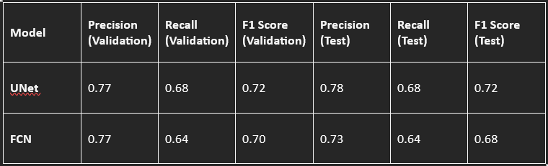
Test Dataset Results:
Both models were evaluated on a test dataset containing multi-spectral satellite images and their corresponding ground truth for landslide detection. The performance metrics for both models on the test data are summarized below.
UNet achieved a Precision of 0.78, a Recall of 0.68, and an F1 Score of 0.72 on the test data, indicating good segmentation performance with balanced detection and error rates.
FCN achieved a Precision of 0.73, a Recall of 0.64, and an F1 Score of 0.68 on the test data. While the precision was lower than that of UNet, it still performed reasonably well in identifying landslide areas, albeit with a slightly higher rate of false negatives (lower recall).

Slide 16
Findings and Key Observations:
Both models showed a similar Precision on the test dataset, but UNet outperformed FCN in terms of Recall and F1 Score. This suggests that UNet was more effective at detecting the true landslide regions with fewer false negatives.
FCN demonstrated slightly lower performance in terms of recall and F1 Score, indicating that while it can segment landslides effectively, it may miss some areas that are classified as non-landslide regions.
The models performed consistently across both validation and test datasets, with UNet showing a small but significant improvement in all key metrics, particularly in recall and F1 score.

Slide 17
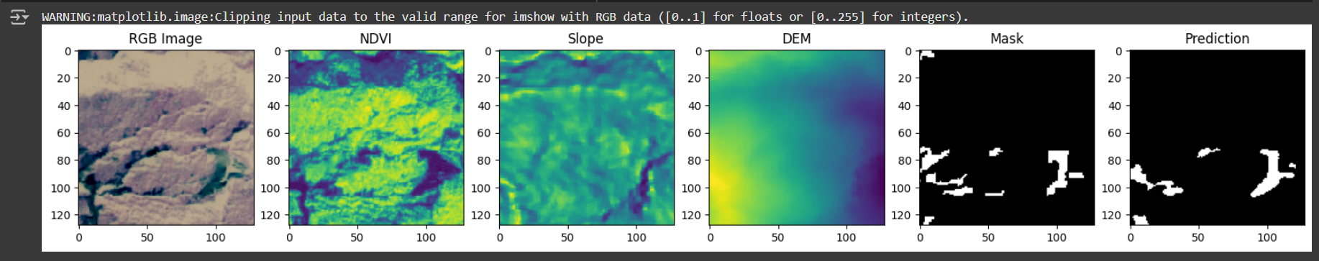
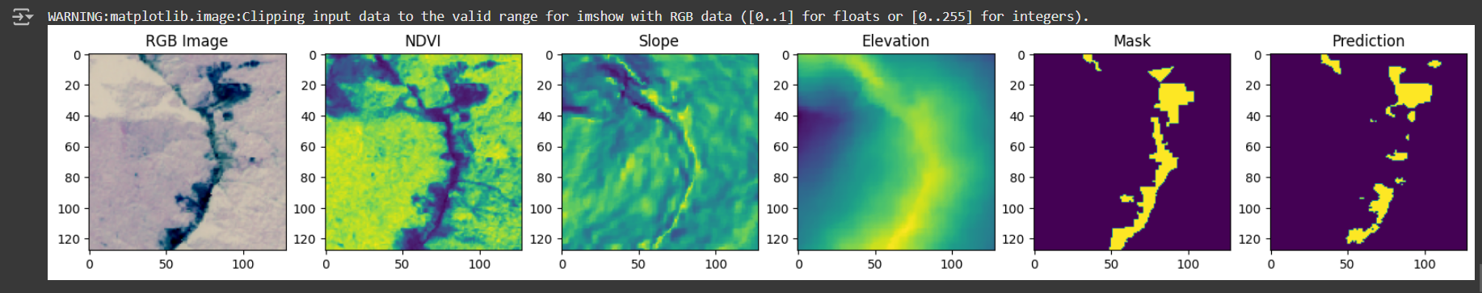
Visual Results:
The visual segmentation results of both models were also evaluated by comparing the predicted landslide areas with the ground truth segmentation. In general, UNet produced more accurate and precise boundaries for the landslide areas, while FCN showed some misclassifications in the finer details of the landslide regions, especially in areas with complex terrain or unclear boundaries.
UNET
FCN

Slide 18
Research Paper Status
Completed:
Introduction and Problem Statement sections are complete.
The objectives and methodology have been outlined and explained.
Proposed system diagram and model architecture are prepared.
Initial results and evaluation have been documented with corresponding metrics.
In Progress:
Further tuning of the model parameters and finalizing the results.
Addition of further visualizations, graphs, and tables for comparison.
Finalizing the Discussion and Conclusion sections based on results.

Slide 19
REFERENCES :
Bui, D.T., et al. (2016). "Spatial prediction of landslides using a hybrid machine learning approach based on logistic regression and support vector machines." Geomorphology, 283, 90-98.
Meena, S.R., et al. (2019). "Landslide susceptibility prediction using convolutional neural networks: A case study of Nepal." Remote Sensing, 11(20), 2397.
Sameen, M.I., et al. (2020). "Landslide susceptibility mapping using convolutional neural network with multi-source geospatial data." Landslides, 17, 227-242.
Ronneberger, O., Fischer, P., & Brox, T. (2015). "U-Net: Convolutional networks for biomedical image segmentation." International Conference on Medical Image Computing and Computer-Assisted Intervention (MICCAI), 234-241.
Wang, T., et al. (2021). "Landslide detection from satellite imagery using U-Net deep learning model." IEEE Access, 9, 19956-19970.
Lu, X., et al. (2022). "Hybrid CNN and U-Net Model for Landslide Detection and Prediction in Complex Terrain." Remote Sensing, 14(5), 1056.

